Slide 1
Systems thinking for terrestrial ecosystem modeling

Slide 2
What are terrestrial ecosystems?

Slide 3
What are terrestrial ecosystems?
Physical, chemical, and biological components of a given area of land that interact with each other and the surrounding environment
Form the basis of the largest scale in ecology, encompassing all other scales

Slide 4
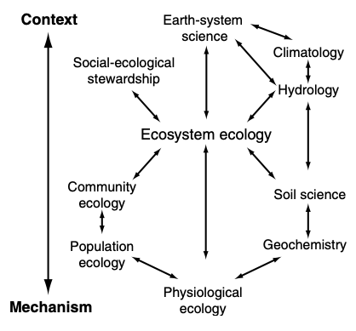
Chapin et al. (2011)

Slide 5
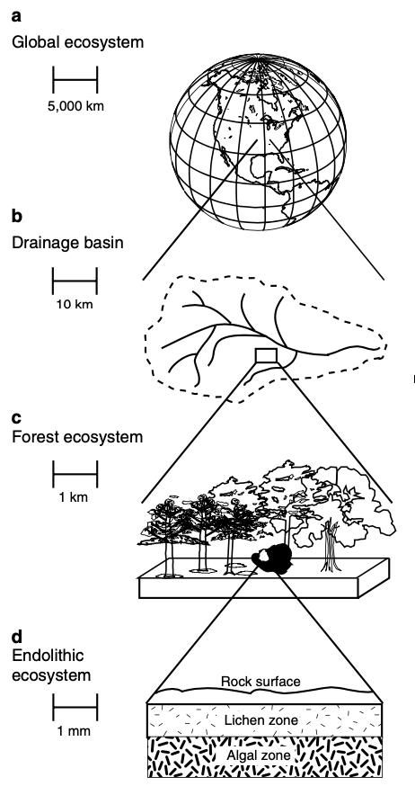
The scale of an ecosystem must be defined
Chapin et al. (2011)

Slide 6
Why study terrestrial ecosystems?

Slide 7
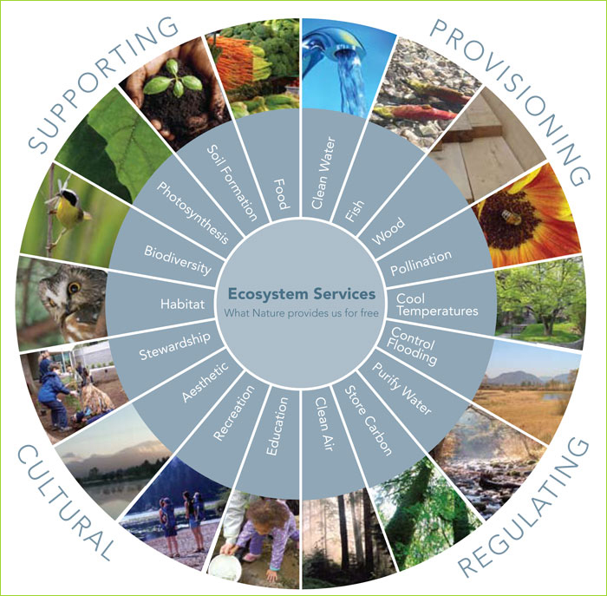
Can any of these be understood without an ecosystem-scale understanding?

Slide 8
Why models?

Slide 9
Why models? Answers from Bonan (2019)
Study system behavior beyond range of measurements
Inform management and policy decisions

Slide 10
Why models? Answers from Bonan (2019)
Study system behavior beyond range of measurements
Inform management and policy decisions
To inform understanding of a system
Using model experiments to generate and test hypotheses
Develop process-level understanding at multiple scales

Slide 11
Why models? Answers from Bonan (2019)
Study system behavior beyond range of measurements
Inform management and policy decisions
To inform understanding of a system
Using model experiments to generate and test hypotheses
Develop process-level understanding at multiple scales
To guide data collection

Slide 12
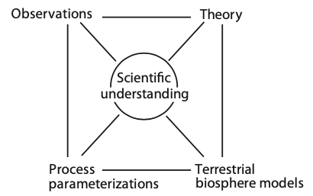
Bonan (2019)

Slide 13
How do we start to model a system?

Slide 14
How do we start to model a system? Let’s start with an example exercise

Slide 15
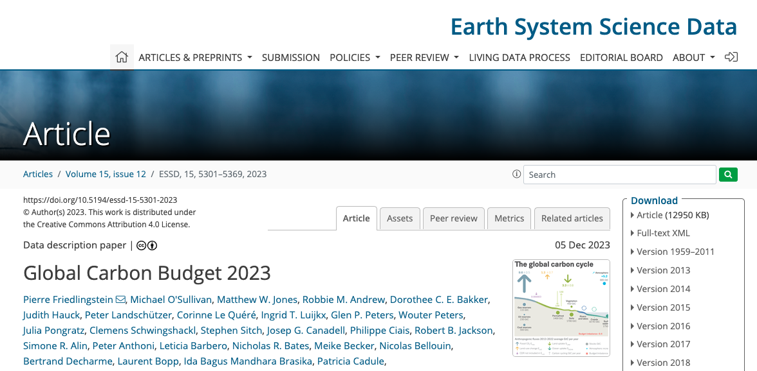

Slide 16
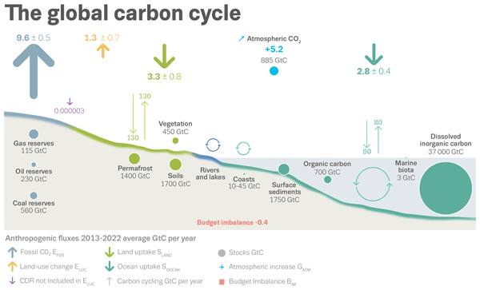
Why is understanding the global carbon cycle important?

Slide 18
Why is understanding terrestrial ecosystems important for understanding the global carbon cycle?

Slide 19
What pools and fluxes are involved?

Slide 20
What factors may influence these pools and fluxes?

Slide 21

Systems thinking is a way to begin piecing each of these together (1) conceptually and (2) quantitatively

Slide 22
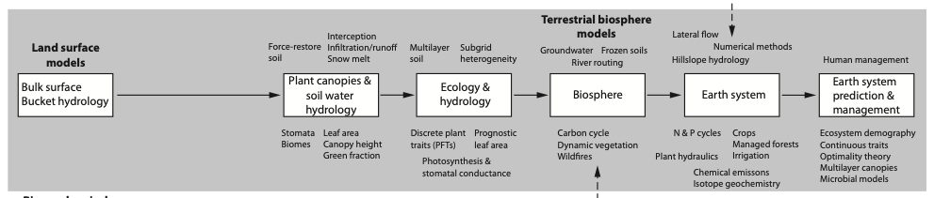
This has been done for LSMs for a long time
Bonan (2019)

Slide 23
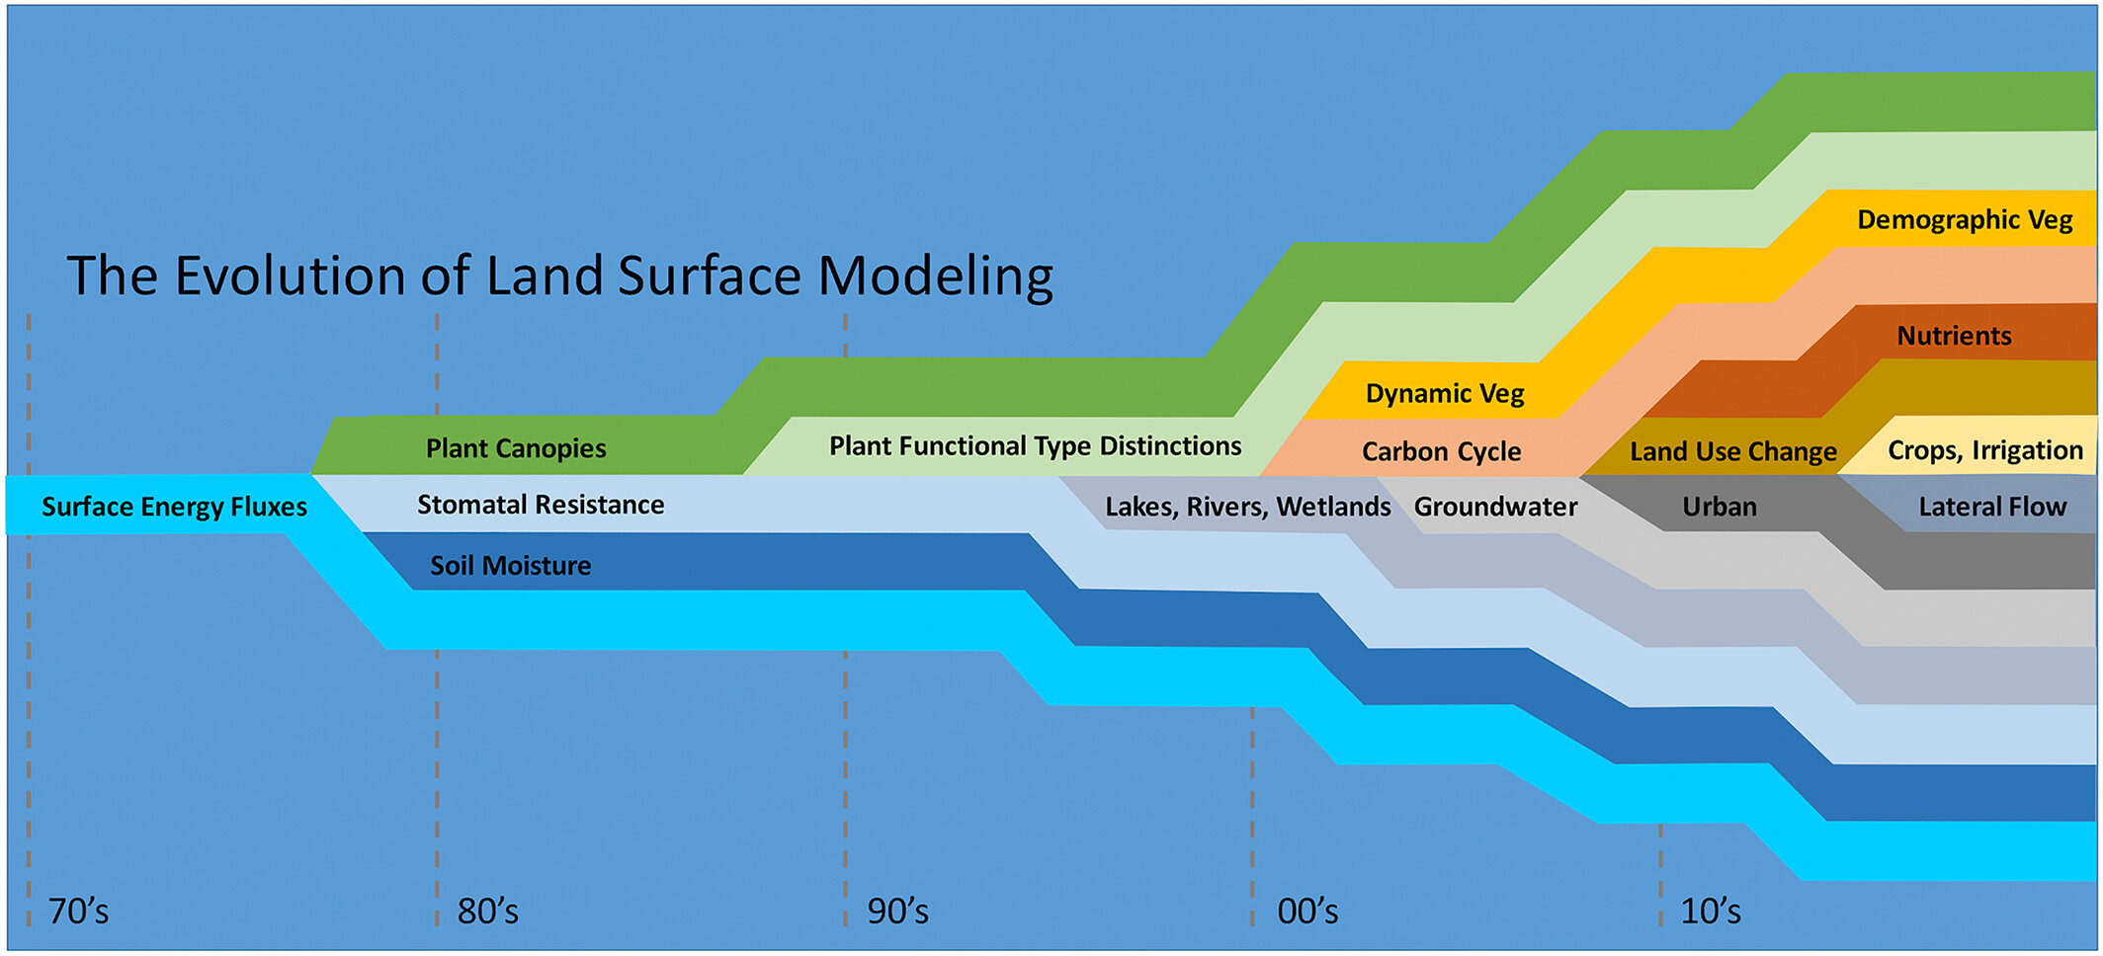
Only moving in one direction: greater complexity (good/bad?)
Fisher and Koven (2020)

Slide 24
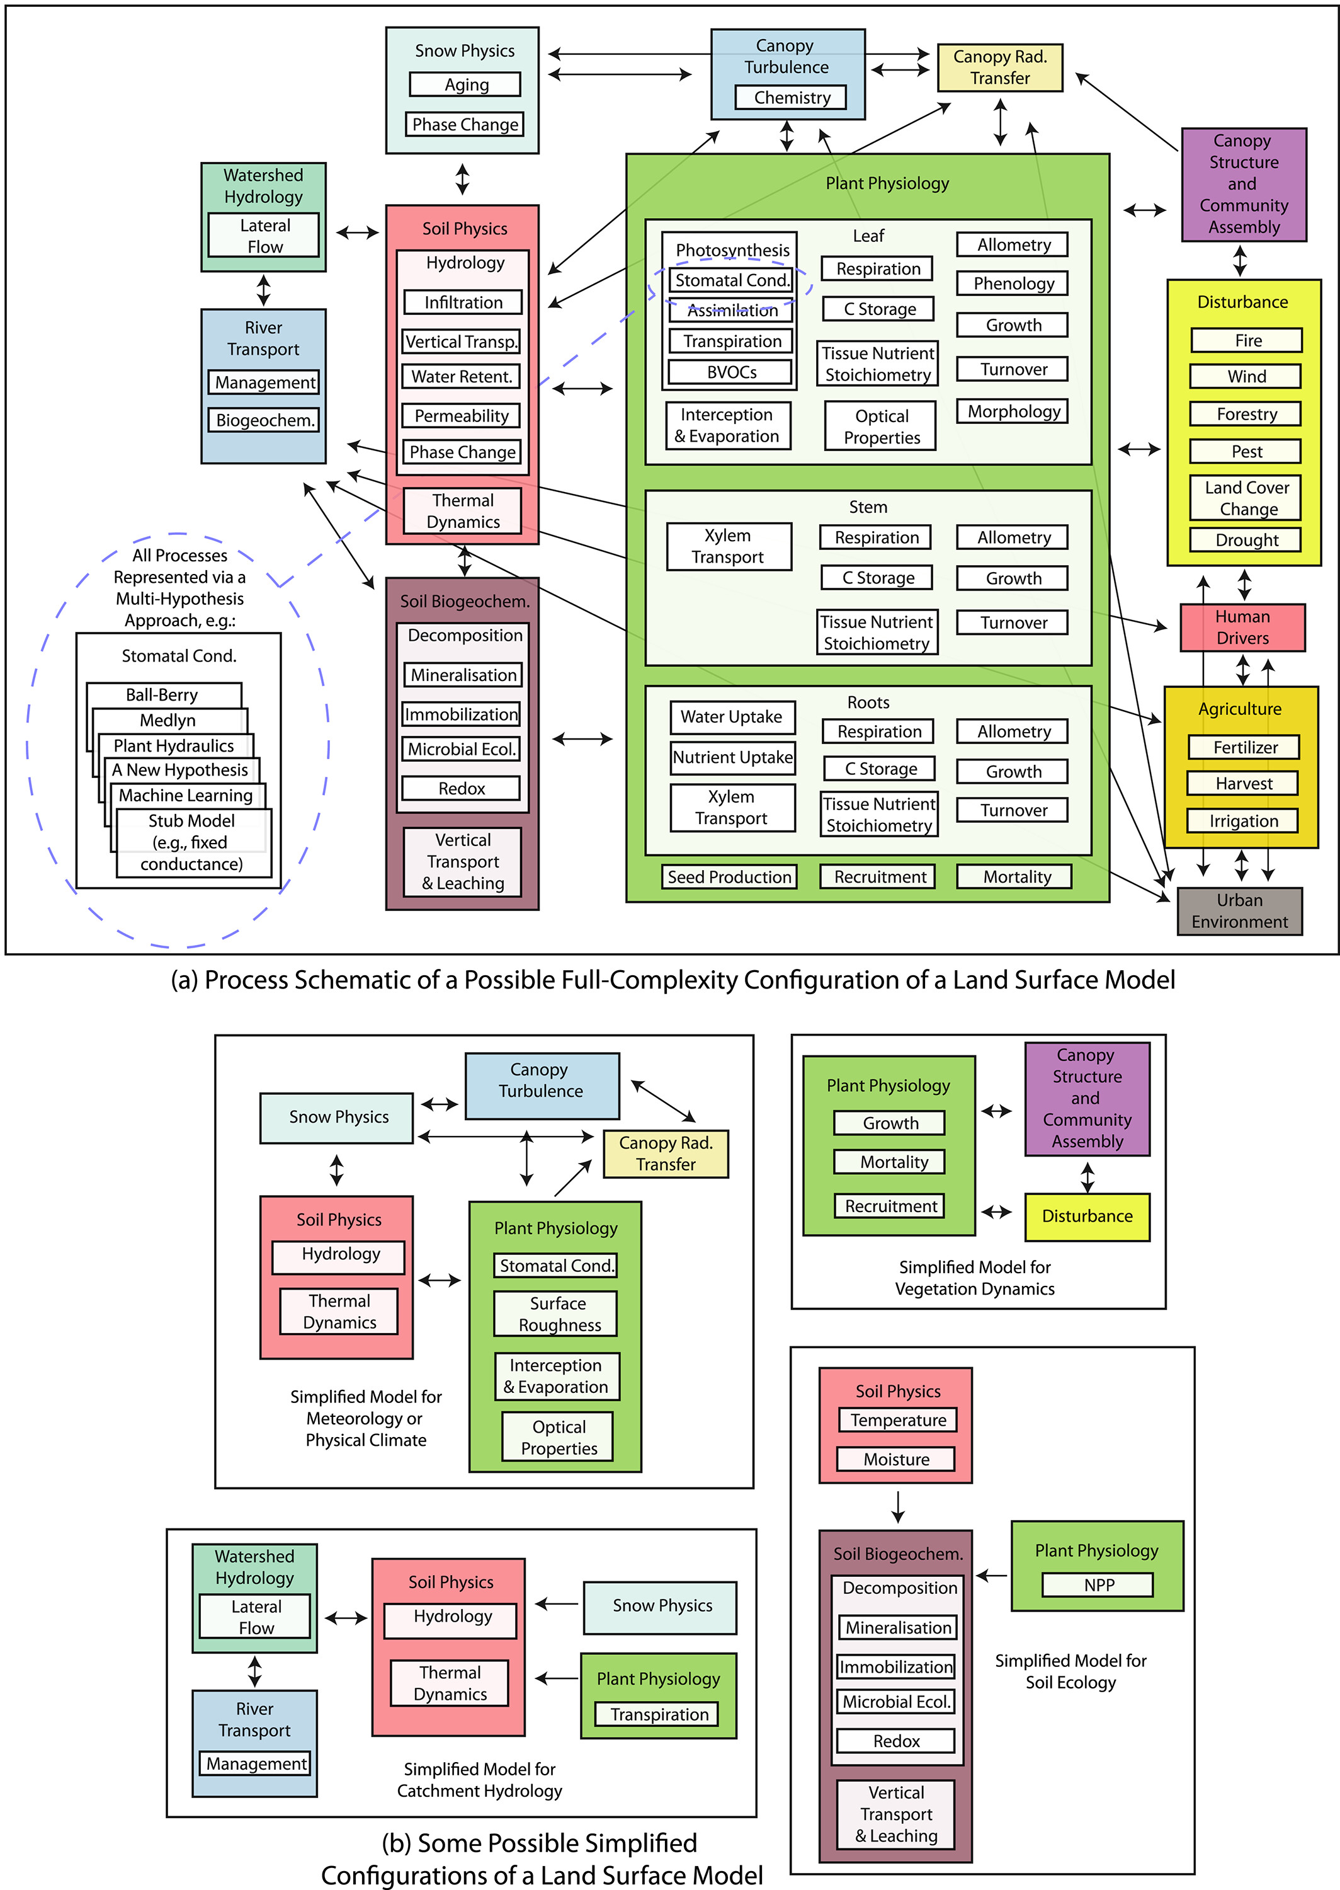
Fisher and Koven (2020)

